Slide 1

EV Charging Demand & Infrastructure Optimization
Data-driven analytics to optimize station placement, reduce wait times, and maximize revenue across Indian cities.

Slide 2
Project Objectives
Peak Detection
Utilization
Hot Zones
Identify highest-demand charging hours
Analyze station usage efficiency
Map high-demand locations
Forecasting
Revenue Optimize
Predict future charging demand
Maximize profit per station

Slide 3
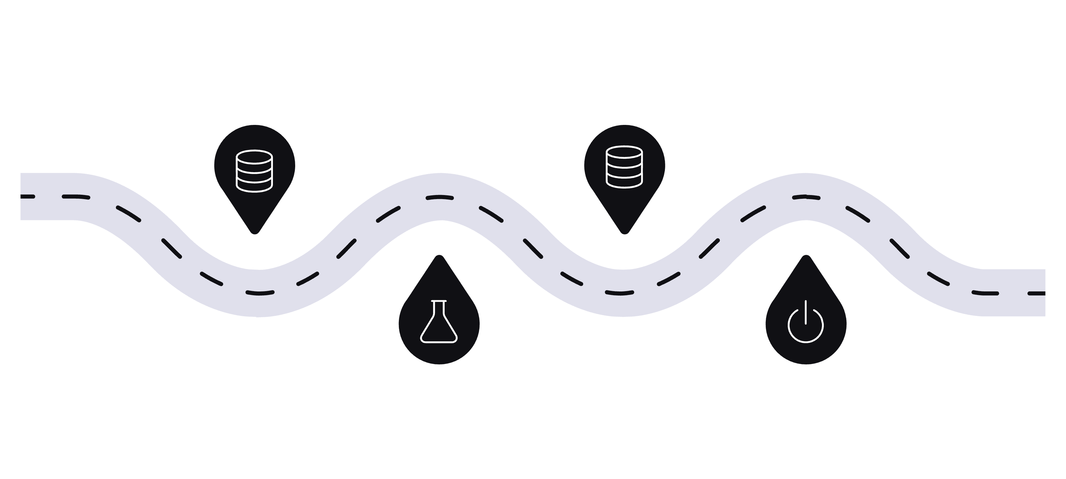
Project Architecture
Storage
Raw Data
Load to SQL database
Kaggle CSV dataset
Data Prep
Visualization
Python EDA, cleaning, features
Power BI interactive dashboard
End-to-end flow from raw data to recruiter-ready insights using Python, SQL, and Power BI.

Slide 4

Dataset at a Glance
4509
9
Total Records
Columns
Charging sessions across India
Station ID, City, Vehicle Type, Energy, Cost, Payment & more
10+
Cities
Delhi, Pune, Kolkata, Bangalore & more

Slide 5
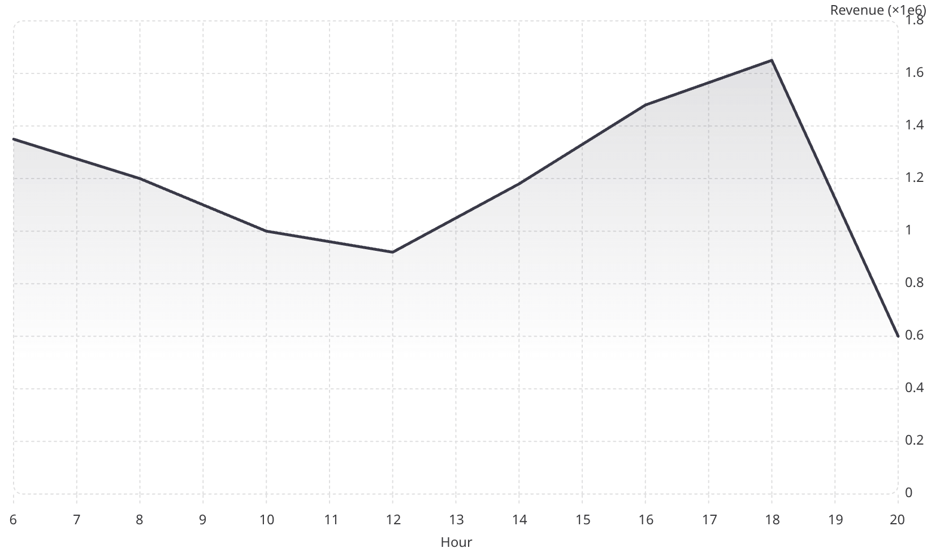
Python EDA: Key Findings
Revenue Peaks at 6–7 PM
Hour 18 leads with ₹1.65M. Sharp drop after 8 PM.
Weekdays outperform weekends
Delhi & Bangalore top revenue cities
Indore & Hyderabad highest utilization

Slide 6
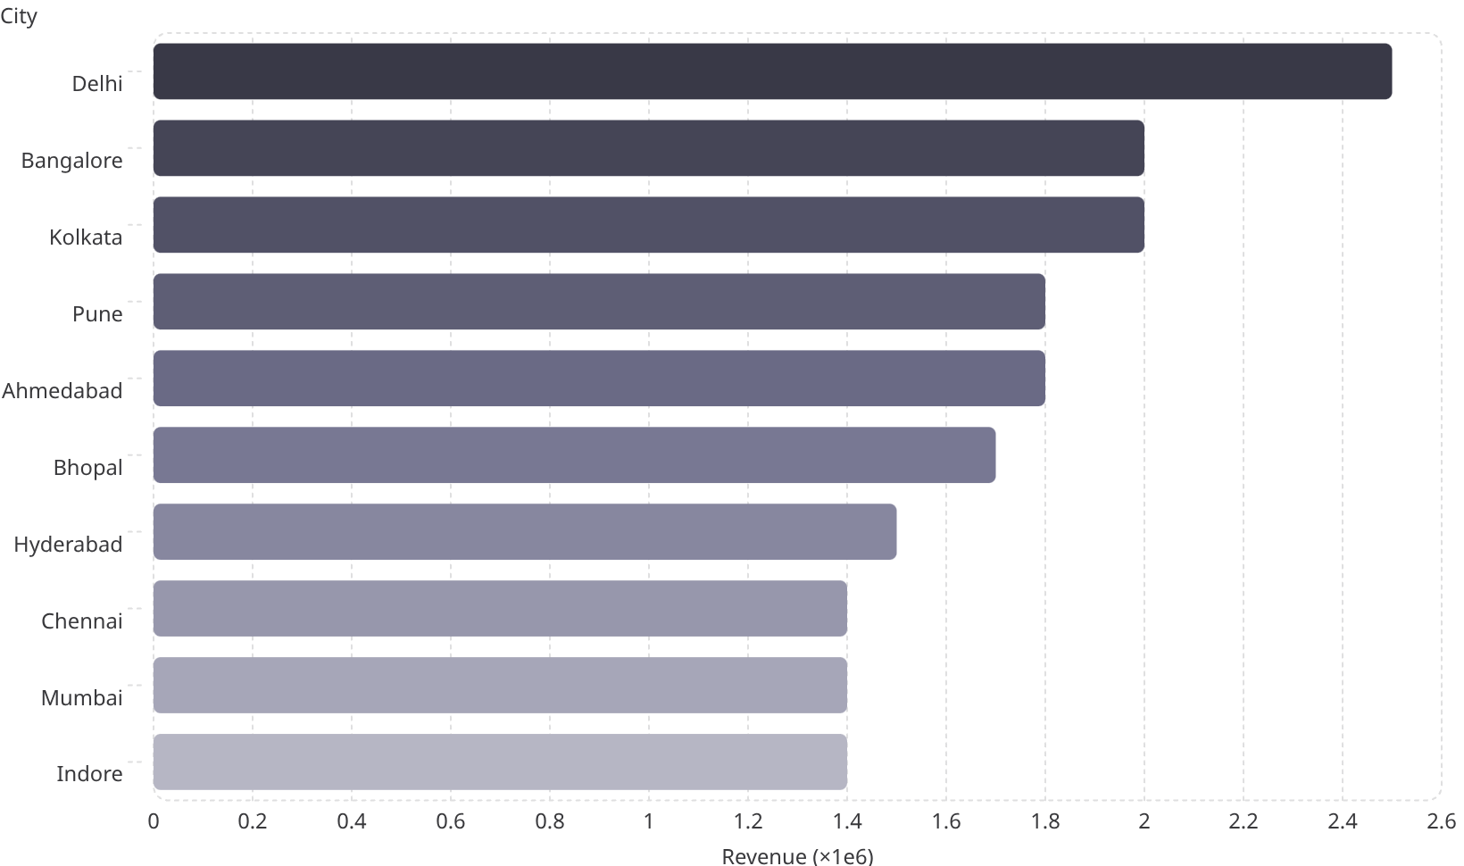

Location & Utilization Analysis
Top Revenue Cities
Delhi leads at ₹2.5M. Ahmedabad & Jaipur show emerging demand.
Indore & Hyderabad have the highest median station utilization rates.

Slide 7
SQL Business Queries
Peak Hours
Total Revenue
Hours 18 & 19 generate top revenue — ₹1.65M & ₹1.63M
₹17.67M across all 500 sessions
Peak vs Non-Peak
Top Stations
Non-peak: ₹12.7M (72%) · Peak: ₹4.9M (28%)
ST443 leads at ₹99.6K; ST026 close behind

Slide 8
Power BI Dashboard
₹17.67M
500
0.07
Total Revenue
Total Sessions
Avg Utilization
₹17.54M
50.00
Profit
Demand Zone Index

Slide 9
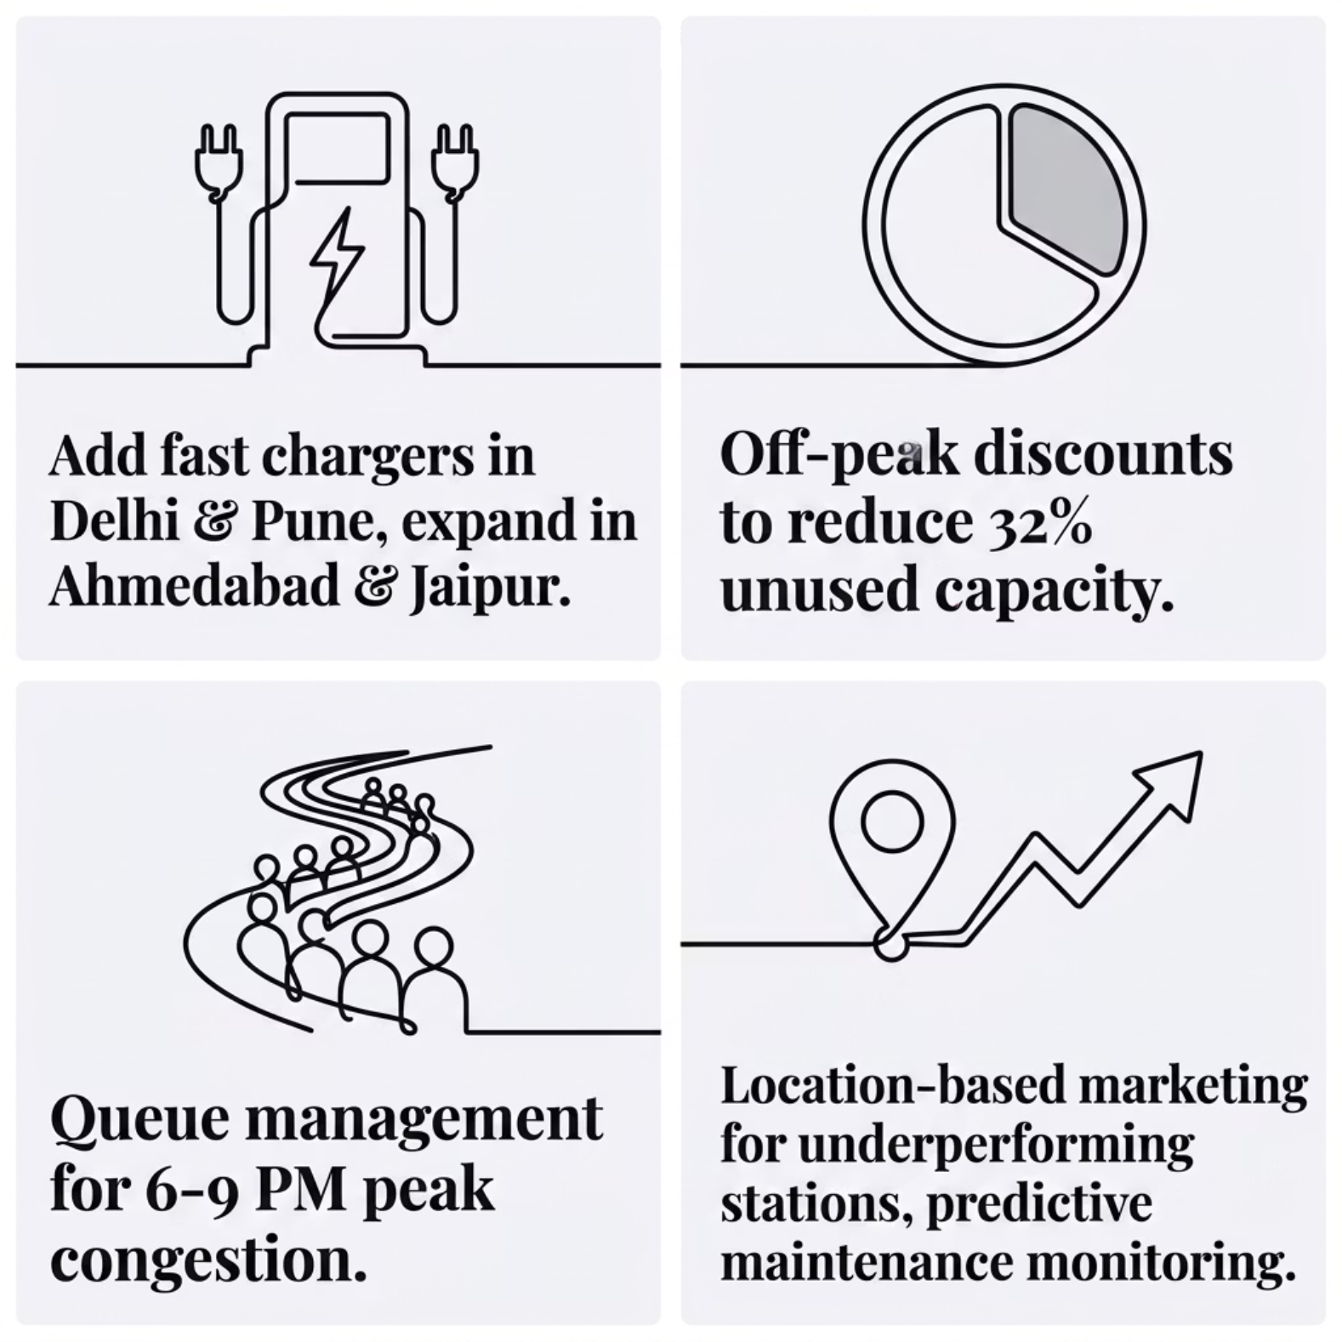

Business Recommendations
Action Priorities
Peak demand: 6 PM – 9 PM
32% unused off-peak capacity
Fast chargers in high-demand zones
Off-peak pricing to boost utilization

Slide 10

Conclusion
Identifies EV charging demand patterns and delivers infrastructure optimization strategies to improve efficiency, reduce wait times, and grow revenue.
Python
SQL
EDA, Cleaning, Visualization
Business Queries & Aggregations
Power BI
Interactive Dashboards
Presented By - Saniya Shaikh

